Slide 1

Face-to-Face to Online
Your personality travels with you……

Slide 2
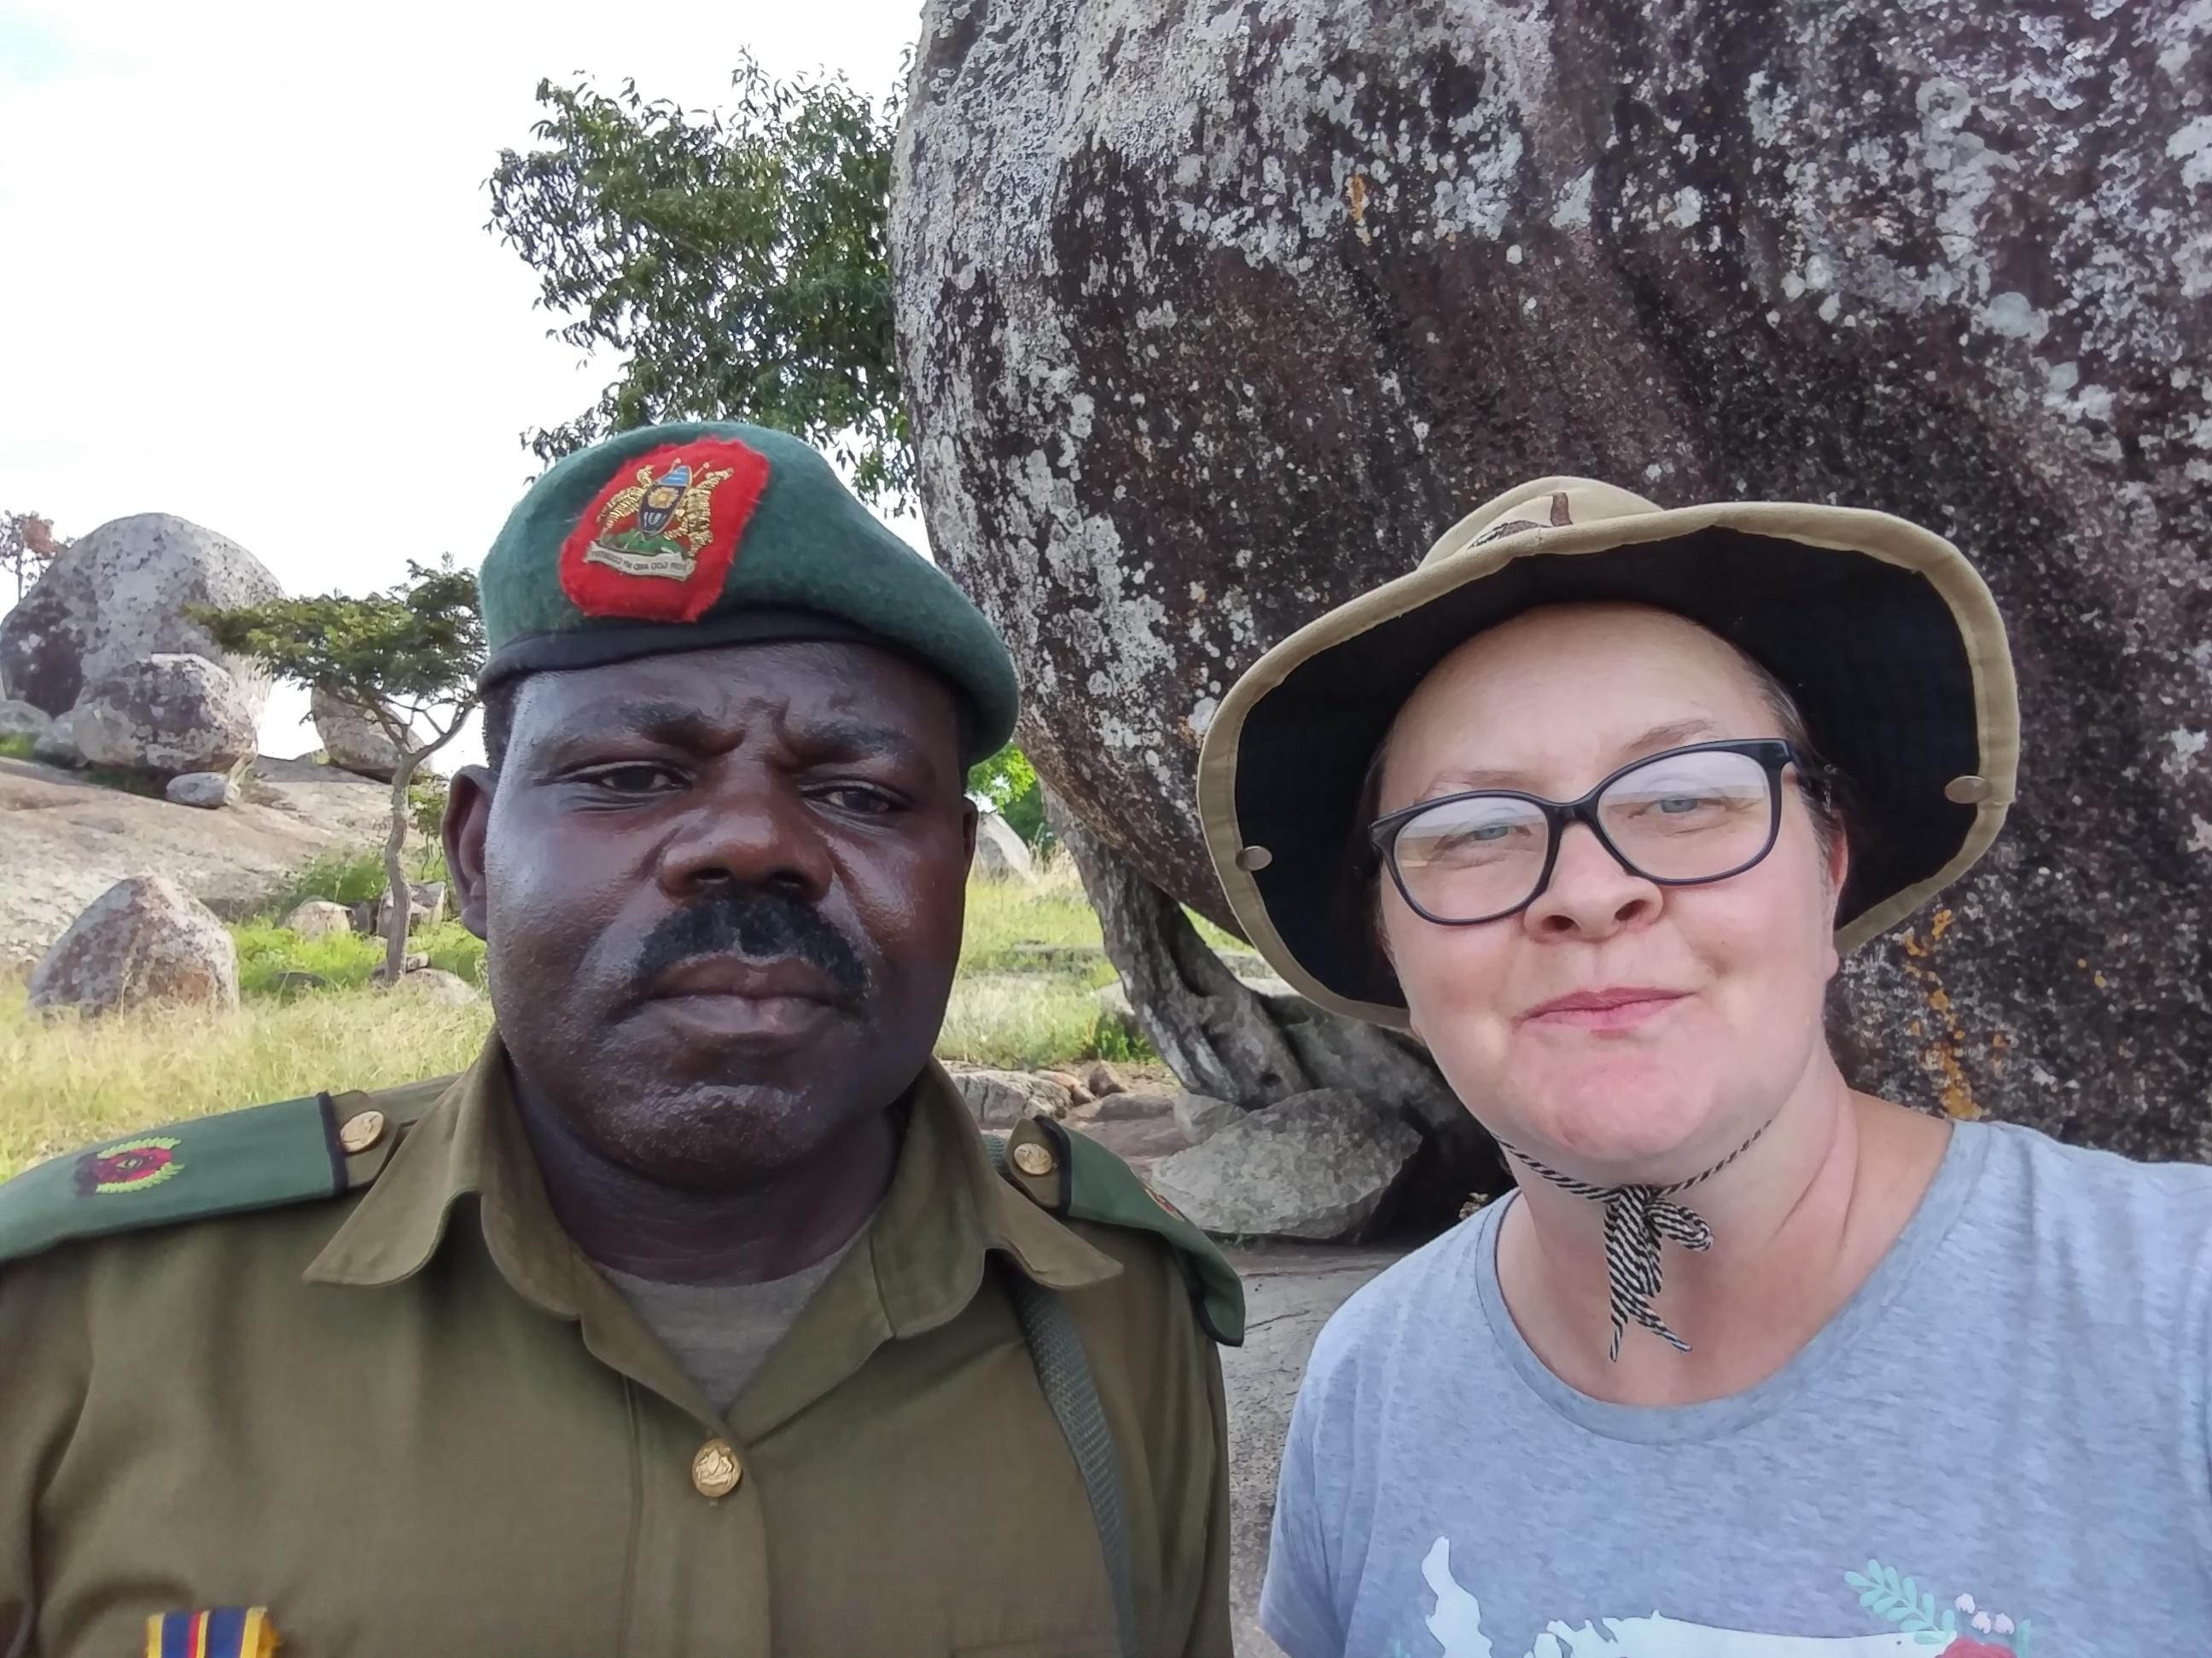
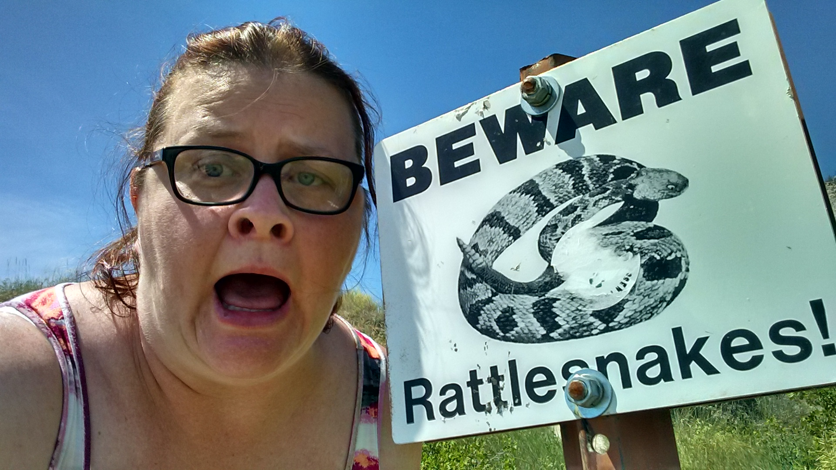
Pauline W. Hoffmann
Who is she?

Slide 3

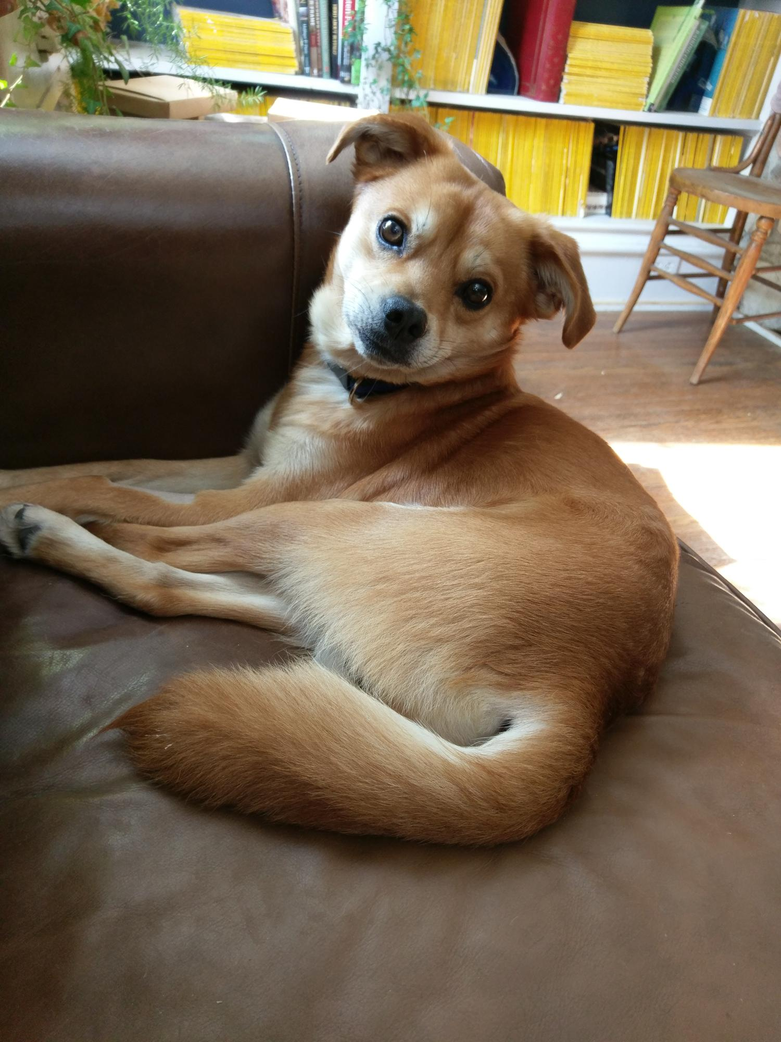
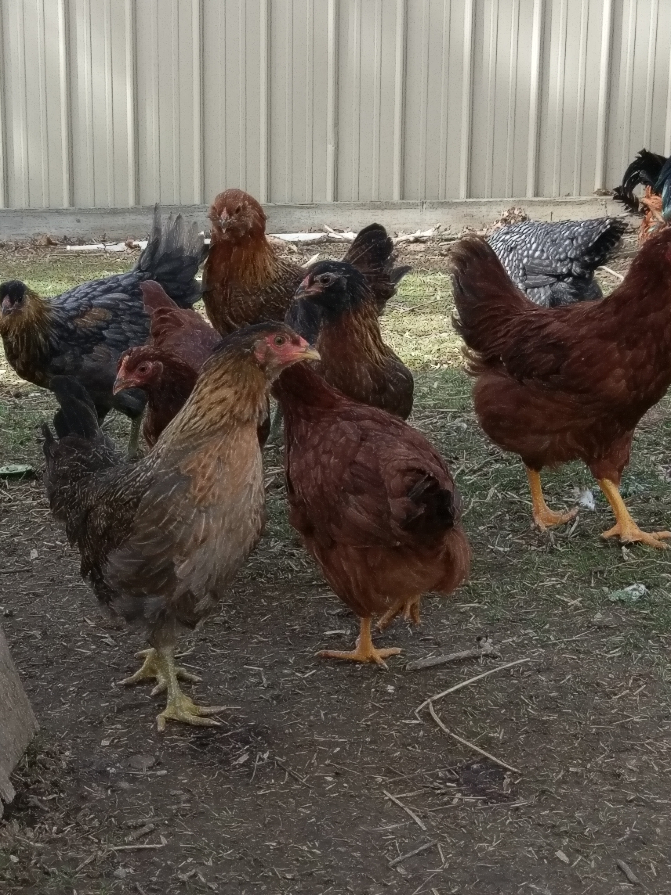
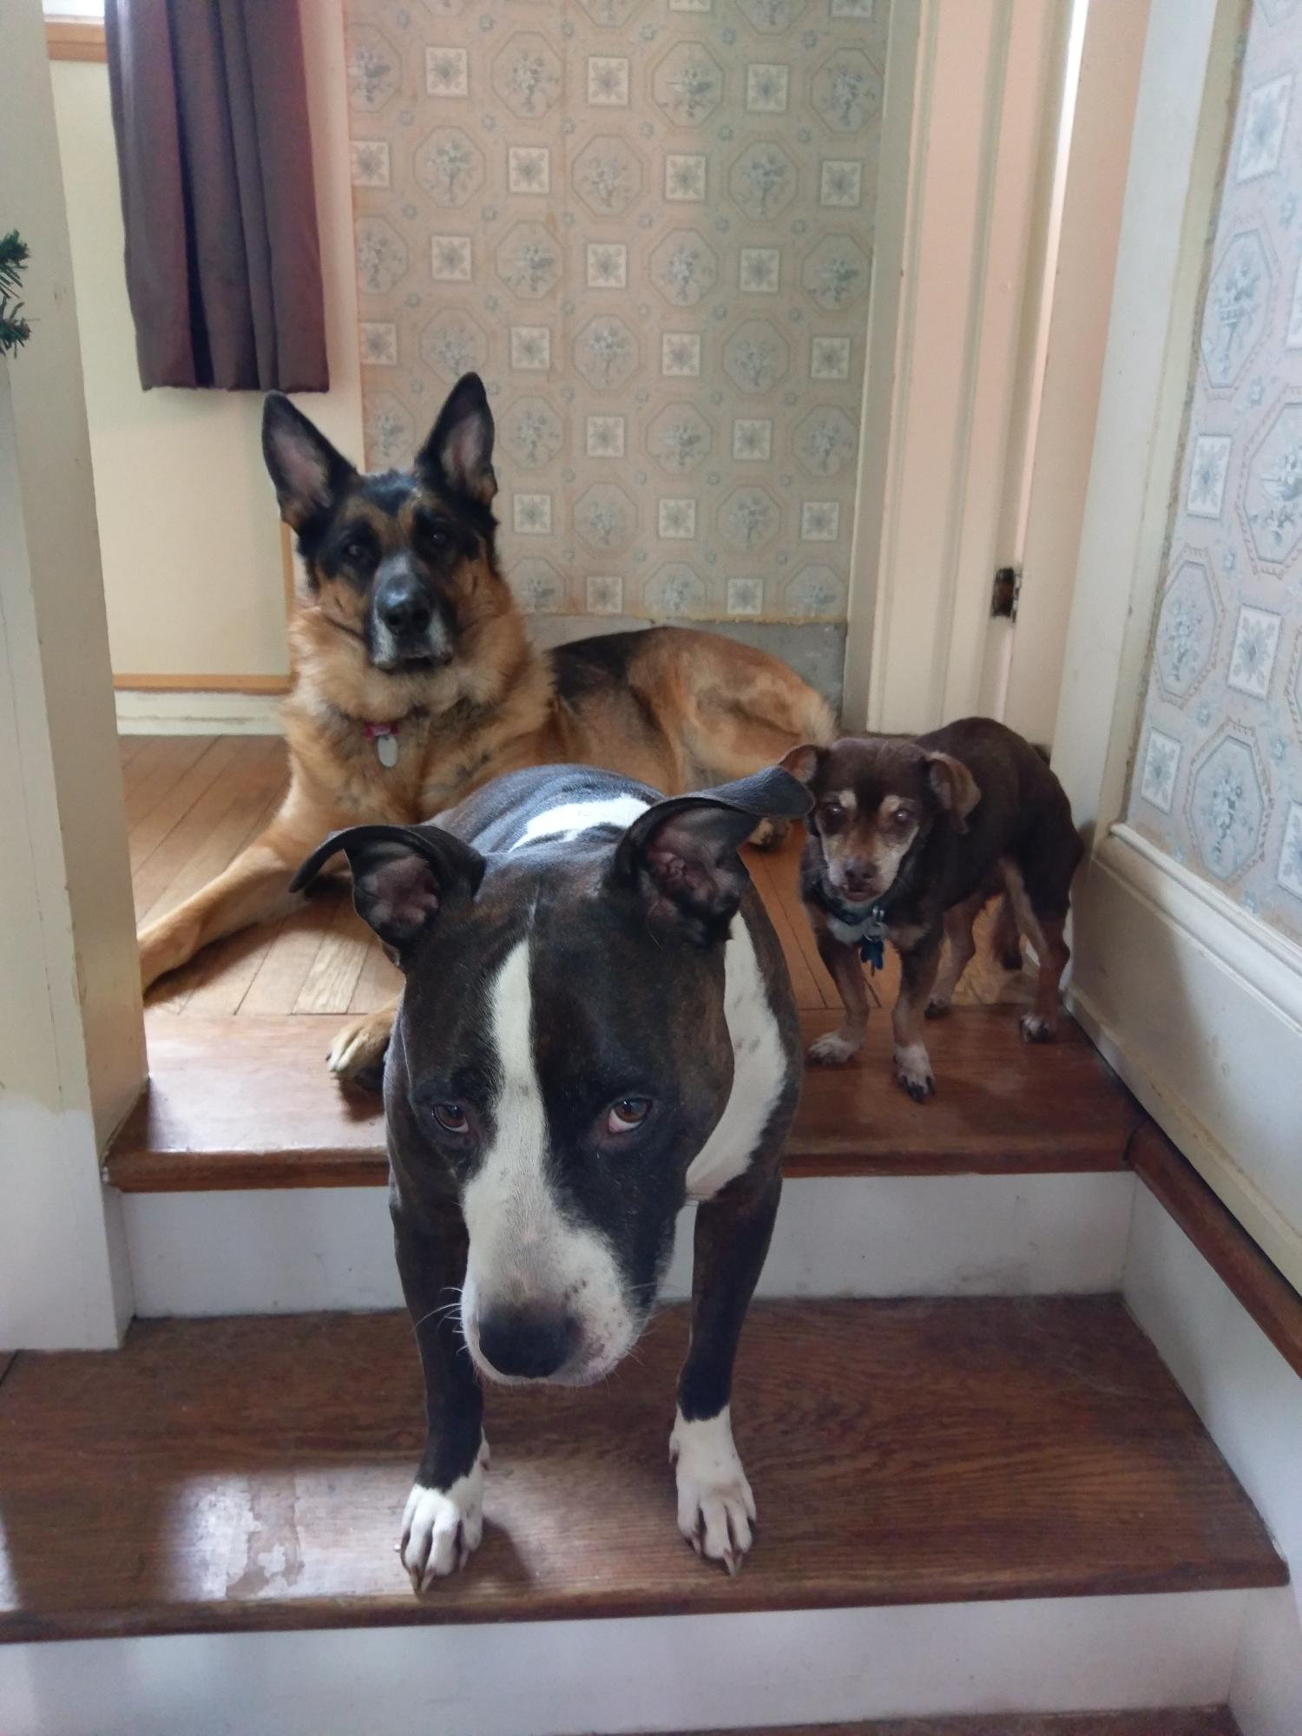
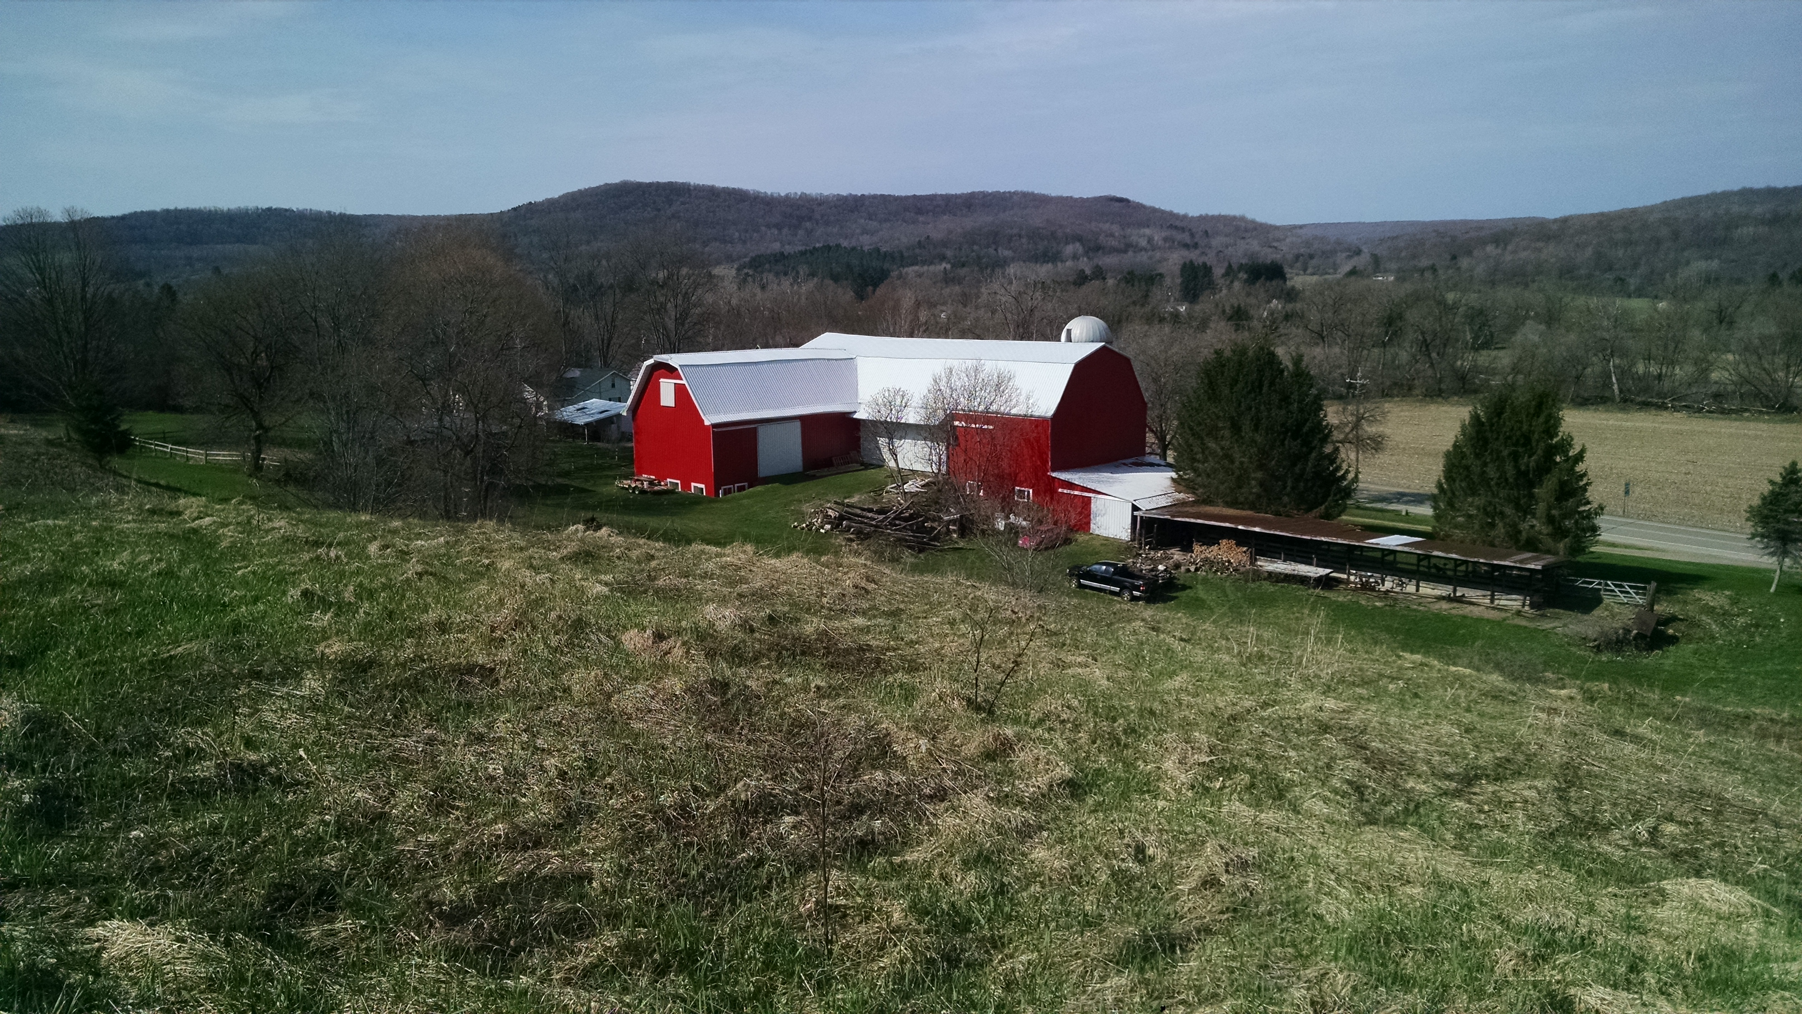
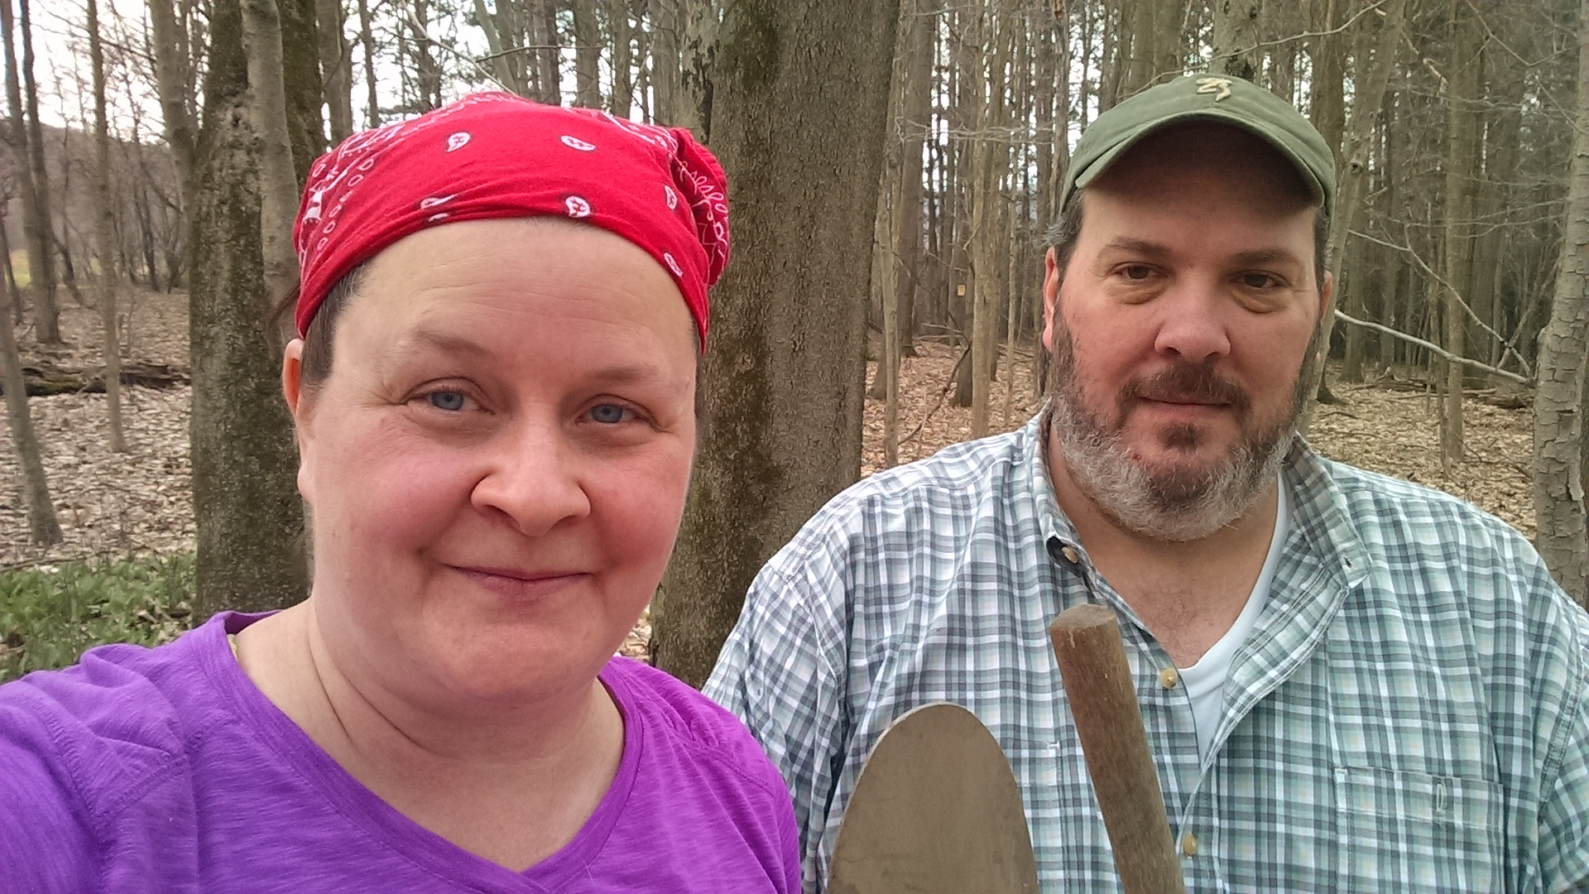
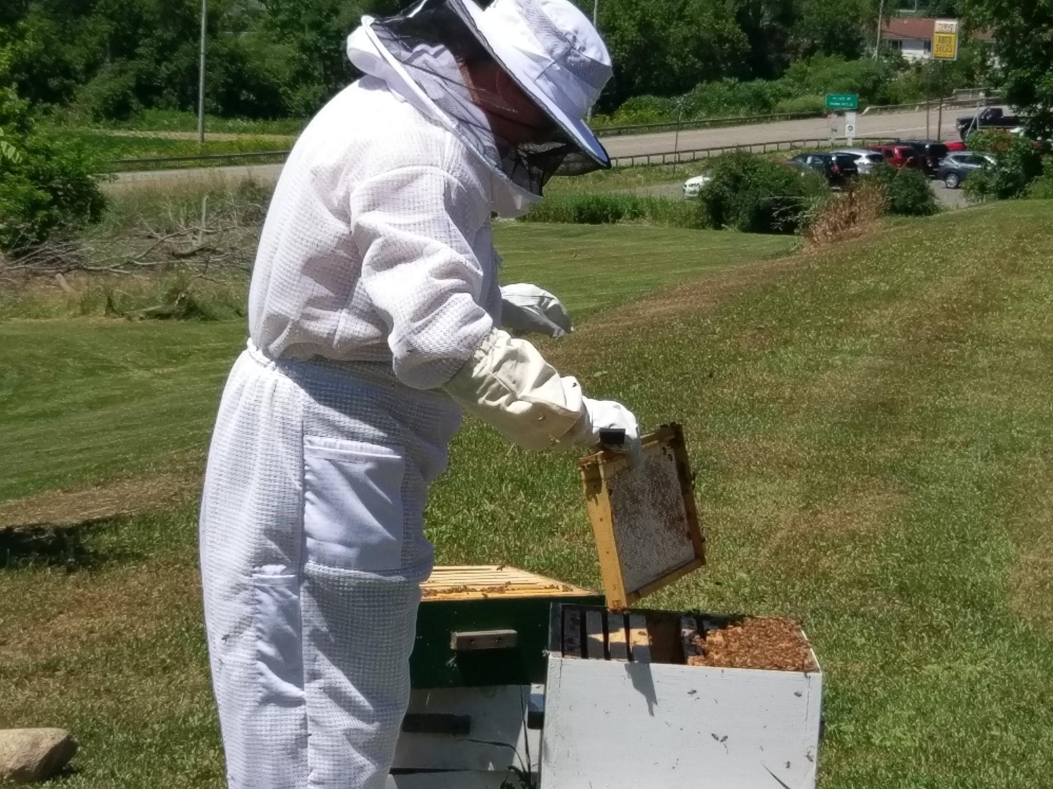
TippyHomestead
TippyHomestead
  My husband and I “bought the farm” a few years ago. We recently started a lifestyle blog: TippyHomestead.com.

Slide 4

Shameful Self-Promotion
Wild Mountain Organics, LLC
  My hobby business – all natural body care.
  I haven’t purchased a lotion or lip balm in years!
[This is not required. This is a shameful plug and a conflict of interest. We can discuss this when we discuss ethics.]

Slide 5
What else have you got?
BonaBRAVE
  March Into Women’s History, Others….
Healthy Community Alliance
  Board Member –joined this wonderful organization dedicated to improving rural health care in the Southern Tier/Western New York.
Embrace It Africa
  I was part of the original group who started this organization dedicated to helping the Bethlehem community in Uganda.
  I try to take students each winter break. See me if you are interested.

Slide 6
And?
Outside Interests
  Reading: I’ve been reading quite a bit. For a list of some recent favorites, go to my website: www.pwhoffmann.com
  Exercise and food: I’ve decided that since I turned 50 I should complete an Ironman. I plan to do Ironman Louisville sometime before I die. Follow my progress on my Instagram feed: @pwhoffmann
  Rights: I will fight for civil/human equity. We all deserve a chance. That’s part of the reason online learning is so interesting to me – we will reach audiences not served in a traditional model.
  Magazines: It is an addiction. I love to read magazines and they run the gamut in terms of interests. National Geographic (NatGeo for my fellow nerds) is a favorite. In fact, I collect NatGeo’s.
  Study Abroad: Anyone interested in Uganda and/or Costa Rica? See me. Like conflict? Rwanda? Ireland?

Slide 7
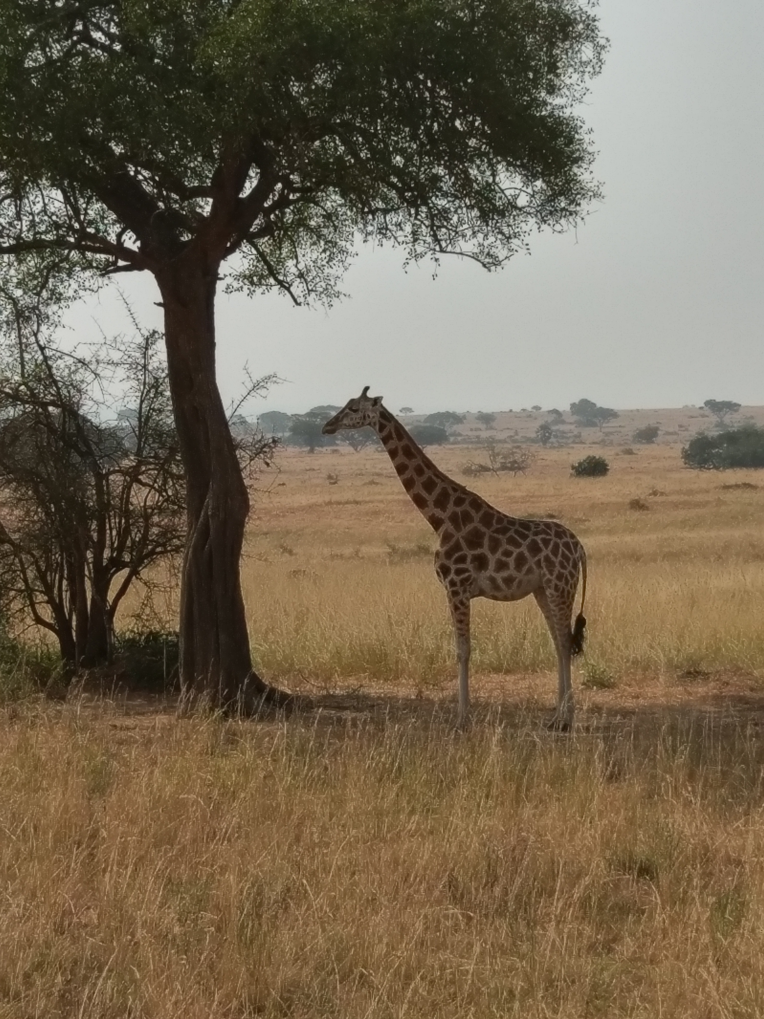
You’re kinda young, what else do you want to do?
Excepts from my bucket list:
  Dive with sharks: I wanted to be a marine biologist but didn’t want to be in a lab for extended periods. I still want to dive with sharks – great whites….in a cage (me in the cage, not the shark).
  Visit national parks worldwide: It would be nice to visit them all, but I’m not that young.
  Learn a foreign language: I learned German in college ages ago. I downloaded the app DuoLingo. It’s kinda helpful if you are also taking a class. If anyone is in SPAN 202 with Dr. Medrano on TTH at 10:00, you will see me learning Spanish!
  For more: www.pwhoffmann.com

