Slide 1

Using Kahoot! as Educational Technology
Presented by:
  Jennifer Eastman &
  John Stevens
Jen

Slide 2

Kahoot is …
A game-based platform that makes learning more engaging using a:
  Quiz
  Survey, or
  Other methods
  To test comprehension or determine what students are learning
John

Slide 3

To begin:
Computer: Google Kahoot! or Click here
Phone: Search App store for Kahoot!
  download
Set up account:
  Enter email address
  Password
Jen

Slide 4
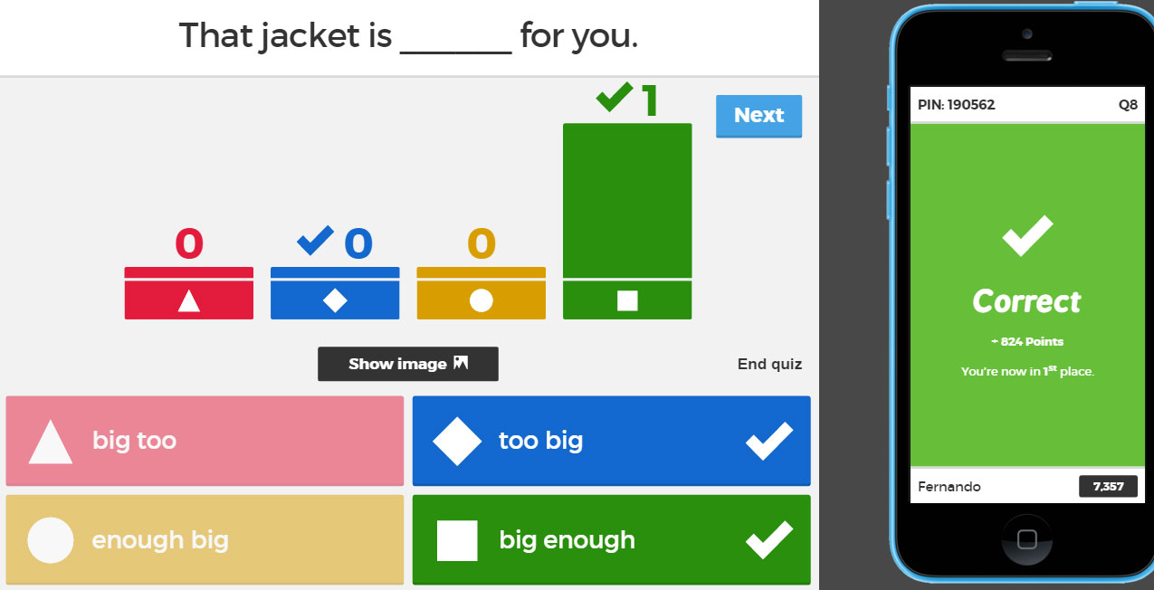
Topics & Links
What is “Kahoot!” ?
App and Computer Use Video
  Create a free educator account here
Play Kahoot!: Intro to Kahoot!
  Go to: https://kahoot.it/ enter code on screen
Create your own Kahoot! here
Accessing & Searching for Kahoots!
Additional Resources for Kahoot!
  Twitter and YouTube
  Google Slides (This presentation)
Jen

Slide 5

First - Let’s see how it works
Play Kahoot!: Intro to Kahoot!
Kahoot! Example
Jen/John
Notes:
johnBsetv…/ Brad1

Slide 6
To administer/create a Kahoot!:
Log into Kahoot! on a computer
Tutorial Videos on how to do just about anything with your Kahoot! can be found on the official Kahoot! YouTube
Jen

Slide 7
Steps
Click “Create”
Select quiz or survey
Give topic a name (Math Review#1)
Upload images (if desired)
Then click “OK, Go”
Begin with Question. #1
  You can upload an image for each question.
  Cont.
Jen

Slide 8
Steps – cont.
Create answers for each question (if quiz/review)
  If survey, create options for survey
When finished click “save”
Play your own Kahoot!
  Go to dashboard
  Select activity
  You can randomize questions / answers under “game options” - cont -
Jen

Slide 9
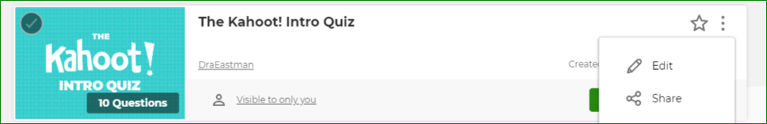
To play Kahoot!
Click on share to get link
Hyperlink via PowerPoint or share via link
Jen

Slide 10
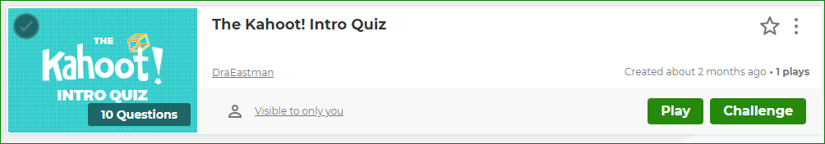
To play Kahoot!
When you hit “play” a number pops up on screen (which students need to enter on their smartphone to play)
Jen

Slide 11
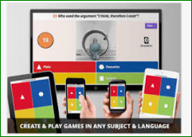
To play Kahoot!
Students should have already downloaded Kahoot! from App store onto cell phones (they can also use web browser on computer)
Jen

Slide 12
Cont.
Students open Kahoot! App or go to https://kahoot.it/
Displays a unique code to play (on projector)
  Students enter code and a “nickname”
When ready to begin, Click “start”
Questions come up one at a time
When all students have entered an answer, click next
Kahoot! shows Quiz / Survey results by question
Jen

Slide 13

When finished…
You can save the quiz / survey results to an excel spreadsheet
Your Kahoots are saved under the “Kahoots” tab on top ꜜ
John/Jen

Slide 14
In addition…
There are many existing Kahoots you can preview and copy to your account
You may want to purchase a subscription (optional)
Jen

Slide 15
Questions?
Thank you for attending!
For additional support:
Twitter and YouTube
For a copy of this presentation: Google Slides
Jen

